Slide 1
Image deblurring using autoencoders
Pratyay Dutta, Aditya Gambhir

Slide 2
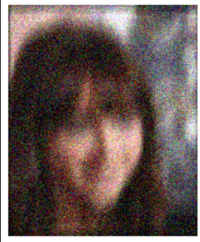
Problem
We have a blurred image

Slide 3
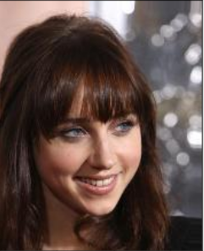
Problem
We have a blurred image
We want to get a sharp image

Slide 4
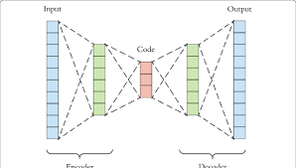
Motivation for solution
Autoencoders are feature learning models.
It encodes an input to a lower dimensional space thereby adding noise to it
We decode that encoding using the complementing algorithms and get back a reconstructed image.

Slide 5
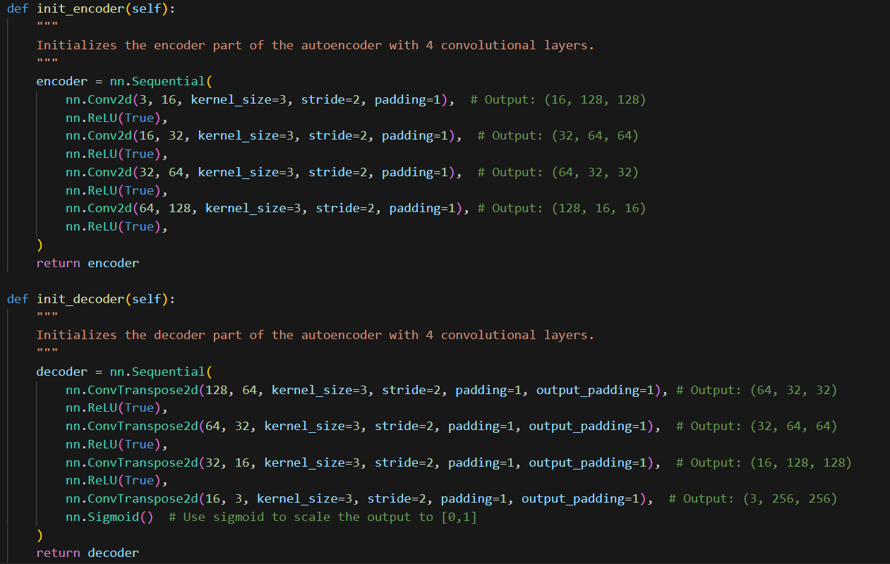
Algorithm
We use an autoencoder model to reconstruct sharp images from blurry images.
The loss function = MSE loss
The loss function calculates the pixel wise MSE loss of the reconstructed image and the ground truth image.
Optimizer = We do backpropagation using Adam optimizer
Our architecture of the autoencoder containing 4 convolutional and deconvolutional layers

Slide 6
Datasets used
We train our model on this dataset.
We do incremental learning. We train it on:
CelebA
HIDE
Wideface

Slide 7
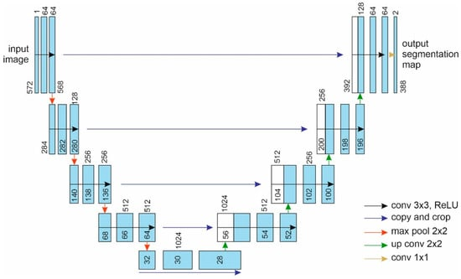
Model architecture and hyperparameters
Architecture used : Classic Encoder Decoder architecture
Hyperparameters:
Learning rate = 0.001
Epochs = 20
Kernel size of convolution = 3
Illustration of a classic encoder decoder architecture. Our model has lesser convolutional layers

Slide 8
Metrics for evaluation on test set
MSE = The mean squared loss calculating the pixel wise L2 loss

Slide 9
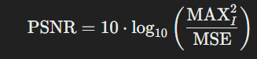
Metrics for evaluation on test set
MSE = The mean squared loss calculating the pixel wise L2 loss
PSNR (Peak Signal to Noise ratio) = measures the ratio between the maximum possible power of a signal and the power of corrupting noise

Slide 10
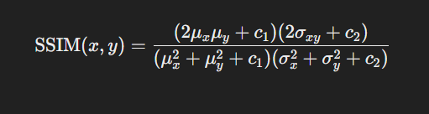
Metrics for evaluation on test set
MSE = The mean squared loss calculating the pixel wise L2 loss
PSNR (Peak Signal to Noise ratio) = measures the ratio between the maximum possible power of a signal and the power of corrupting noise
SSIM = evaluates the perceived quality of digital images and videos by comparing changes in structural information, luminance, and contrast between an original and a reconstructed image.

Slide 11
Results – Testing
Dataset | PSNR | SSIM | MSE
CelebA | 19.9094 | 0.7404 | 0.002
GoPro | 23.7087 | 0.8146 | 0.001
TextOcr | 23.9223 | 0.8338 | 0.001
Helen | 27.1433 | 0.8933 | 0.001
We give our test results on the ‘test’ split of the datasets. The images from the test split has not been used for training at all i.e the model has not seen the test images before.
A good value of PSNR is around 30
A good value of SSIM is anything more than 92

Slide 12
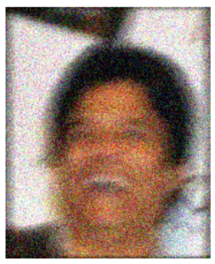
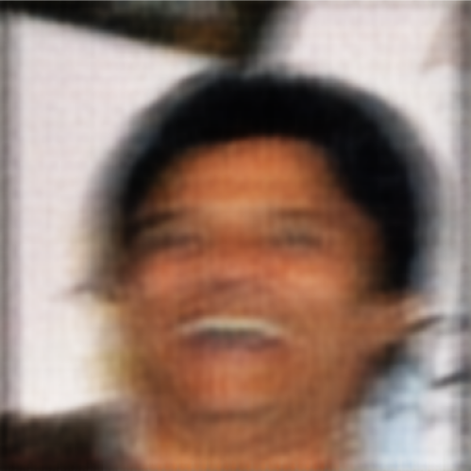
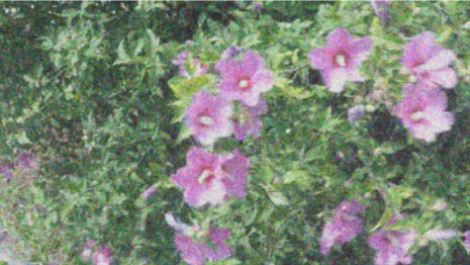
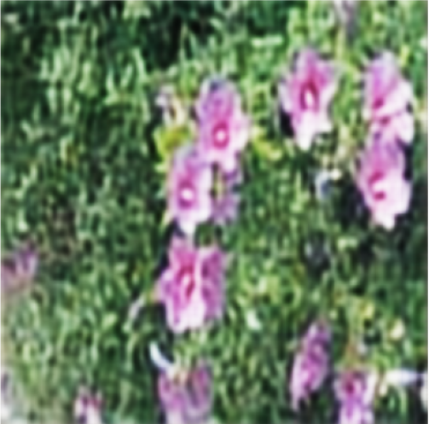
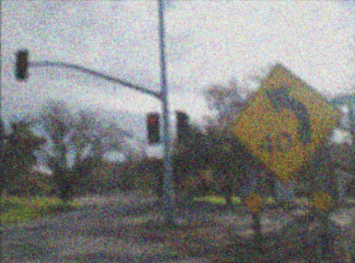
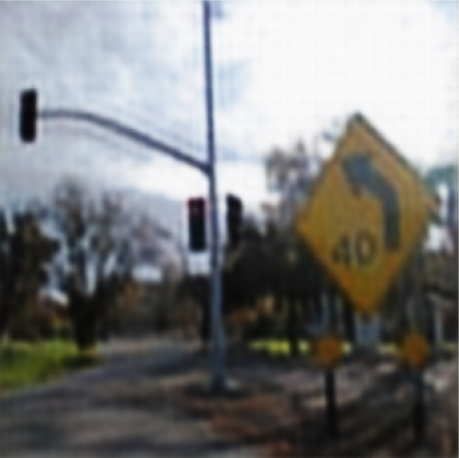
Predictions and demonstration
Blurry image
reconstructed image
This slide shows some predictions we have ran using our model that we have trained.
We see that although the model fails to remove the entire noise, it removes some noise and outputs a coherent picture.

Slide 13
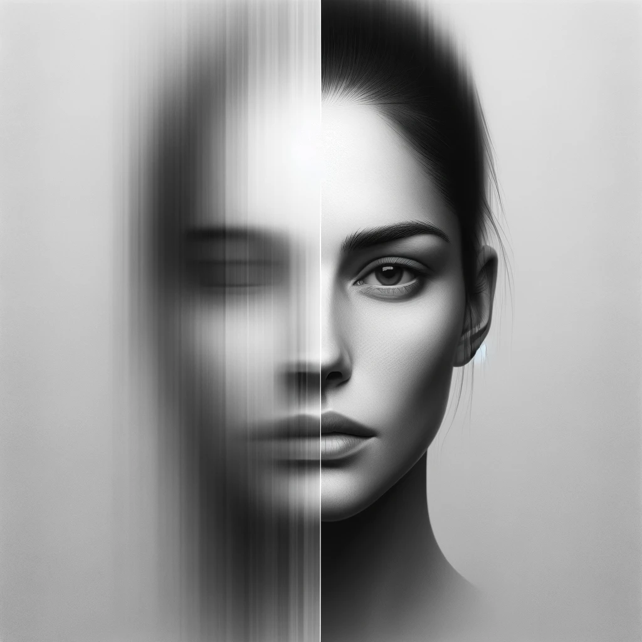
Real life applications
Photography Enhancement: Improving the quality of photos taken in low light conditions, or with shaky hands, by reducing blur and restoring details.

Slide 14
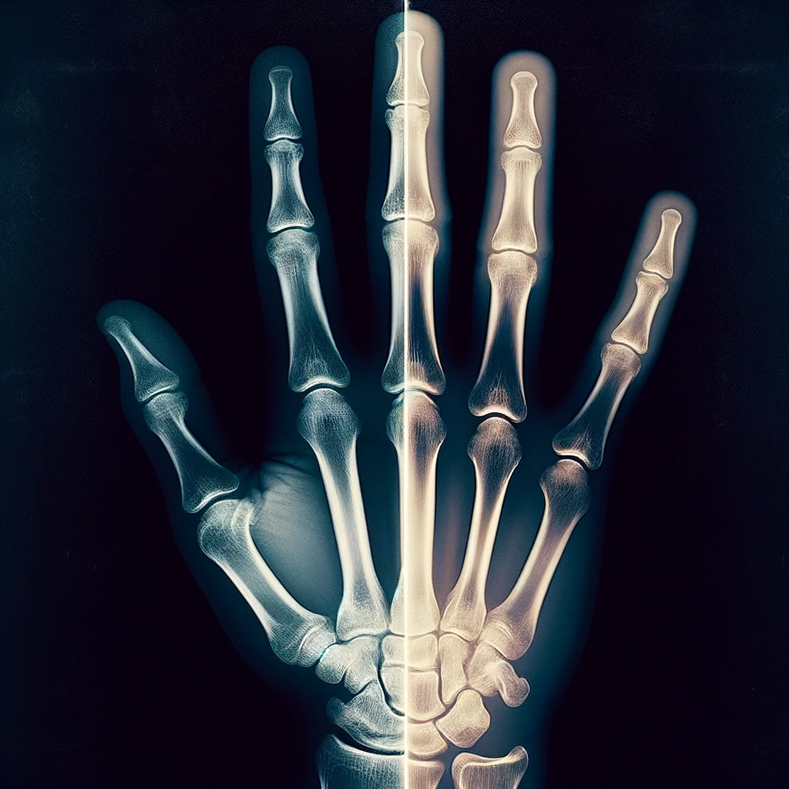
Real life applications
Photography Enhancement: Improving the quality of photos taken in low light conditions, or with shaky hands, by reducing blur and restoring details.
Medical Imaging: Enhancing images obtained from MRI, CT scans, or X-rays to help in more accurate diagnosis and analysis by reducing motion artifacts or blurring effects.
Astronomical Imaging: Improving the clarity of images captured by telescopes, which may be blurred due to atmospheric turbulence, to better study celestial bodies and phenomena.

Slide 15
References
U-Net: Convolutional Networks for Biomedical Image Segmentation
The accuracy of PSNR in predicting video quality for different video scenes and frame rates
Image quality metrics: PSNR vs SSIM
Autoencoders

